Slide 1



A
g
r
I
Image-to-Insight: AI-Powered Farming Decision Support
TEAM MEMBERS : RAVIKIRAN AITHAL(1RV22AI044)
RAKESH H G (1RV22AI042)
S KUSHAAL(1RV22AI047)
NISHANTH UDUPA (1RV22AI033)

Slide 2
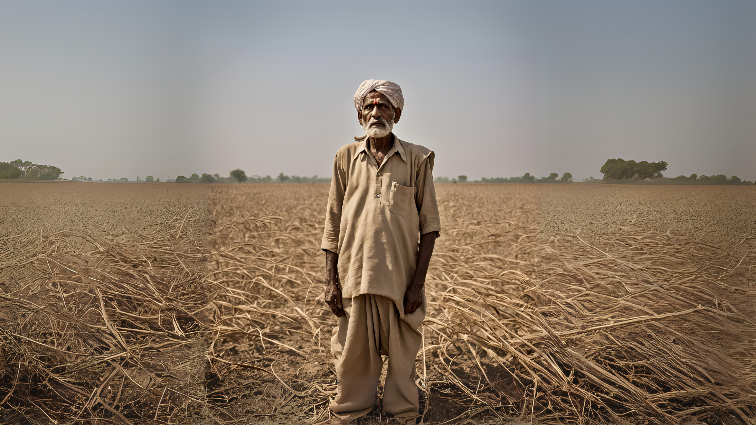

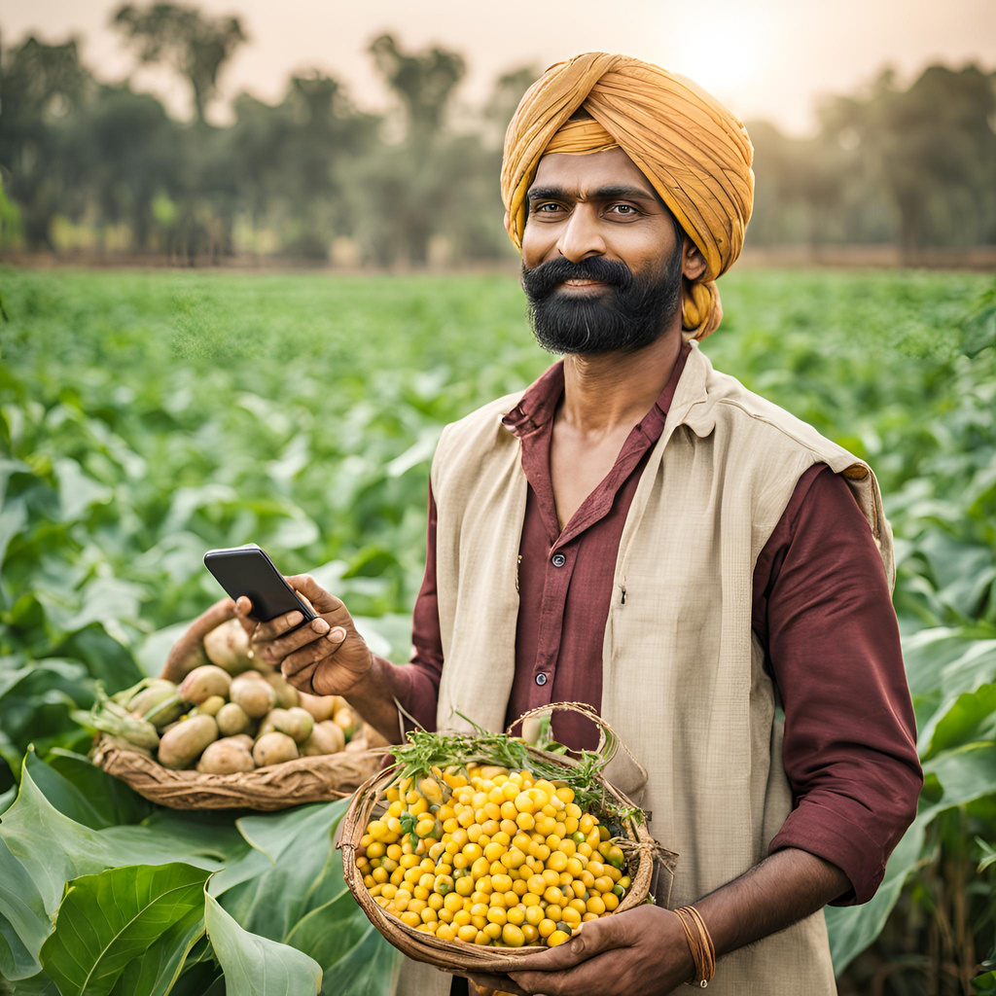

Introduction
Agriculture supports over 60% of India’s population but faces significant challenges, including air pollution reducing crop yields by up to 30% and pests causing 15-25% losses annually, with $10 billion in damages linked to climate variability​ (Insights on India, Mongabay-India).
Additionally, only 48% of farmland is irrigated, making rain-fed areas vulnerable (Down to Earth, Mongabay-India)
The Image-to-Insight AI system offers a transformative solution, enabling farmers to analyze crop photos for real-time insights. This innovative tool supports sustainable practices, precision farming, and improved profitability for India’s agricultural sector.

Slide 3

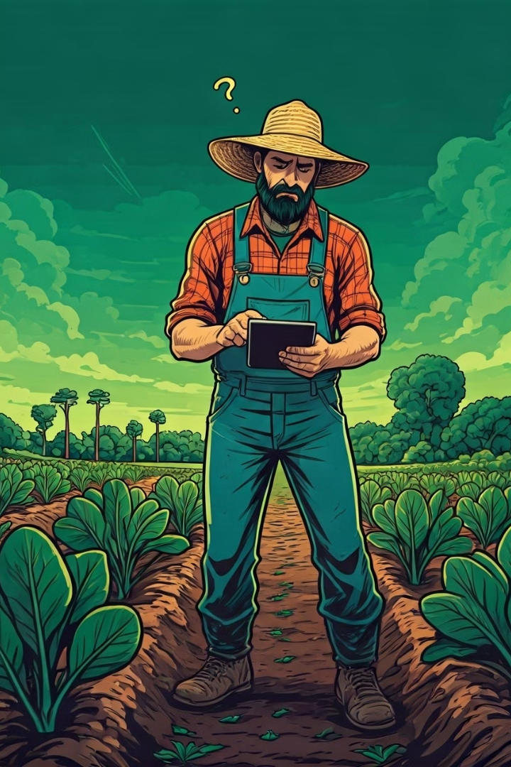
Problem Definition
Addressing Farmers' Pain Points
Lack of Time and Expertise
Inefficient Decision-Making
1
2
Farmers often lack the time and specialized knowledge required to manually analyze crop health and make informed decisions.
Without data-driven insights, farmers struggle to identify and address issues, leading to suboptimal farming outcomes.
3
Missed Opportunities
Inefficient farming practices can result in decreased yields, waste, and missed opportunities for improved profitability.

Slide 4

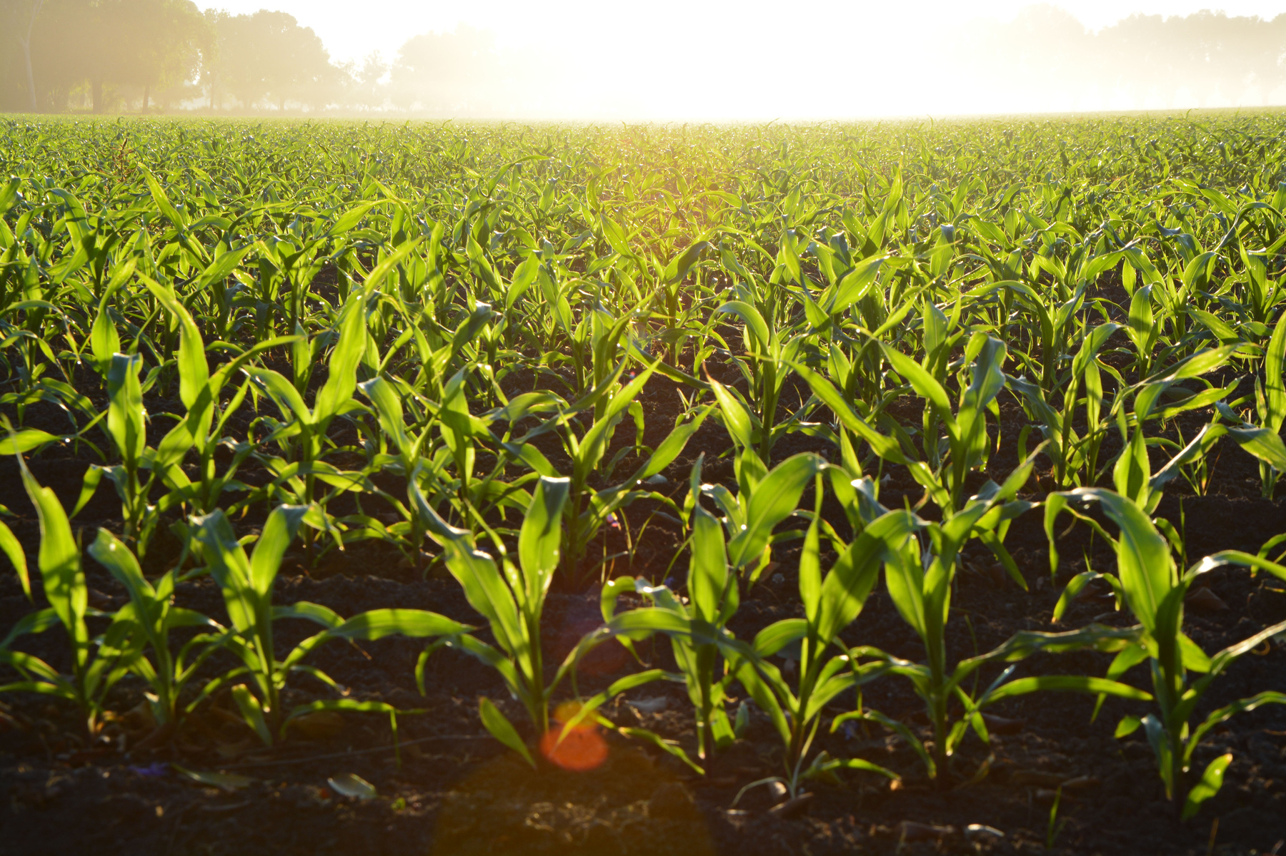
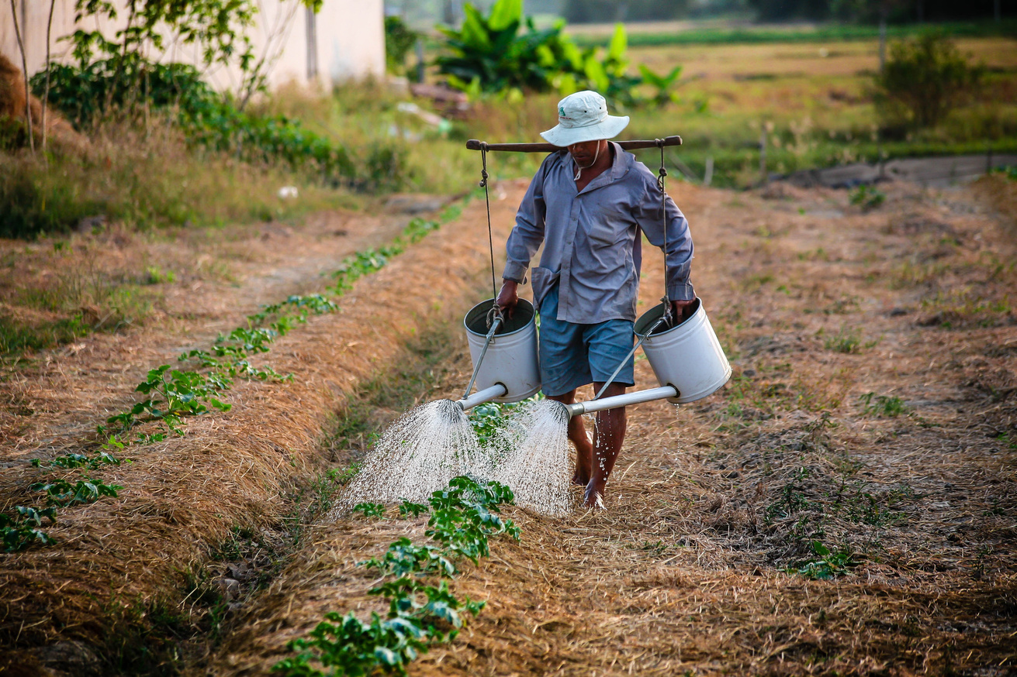
Our Solution
AI-Powered Image Processing
01
The AI system leverages advanced computer vision and deep learning algorithms to analyze crop photos, detecting and diagnosing various issues such as pests, diseases, and nutrient deficiencies.
Personalized Decision Support
02
Based on the insights generated from the image analysis, the system provides tailored recommendations for optimizing farming practices, including targeted treatments, irrigation schedules, and harvesting strategies.
Real-Time Monitoring
03
Farmers can continuously upload crop photos and receive updated insights, enabling them to proactively address issues and make timely, informed decisions throughout the growing season.

Slide 5
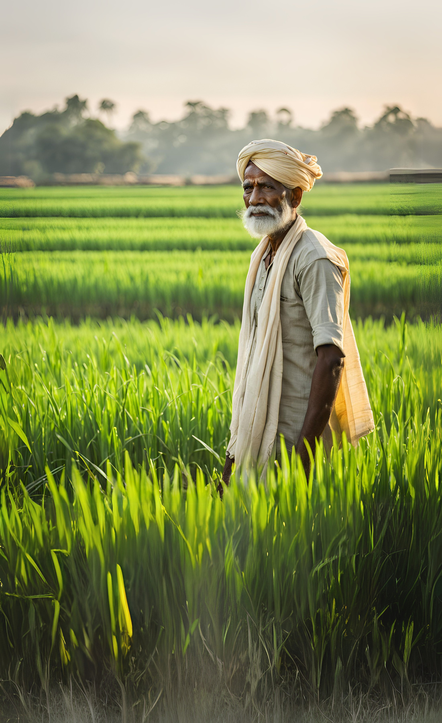
Transform Farming with AgrI
Conclusions:
Increased Crop Yields
Reduced Waste and Inefficiency
The Image-to-Insight system helps farmers identify and address issues early, leading to healthier crops and higher yields, ultimately boosting their profitability.
By providing data-driven insights, the system enables farmers to make more informed decisions, reducing waste, minimizing resource consumption, and improving overall farming efficiency.
Empowered Farming Decisions
With the power of AI-driven analysis and personalized recommendations, farmers can confidently navigate the complexities of crop management and make informed decisions that maximize their success.

Slide 6
Future Scope for AgrI
Crop and Weed Classification
Multilingual Support
Farmer centric web application

Slide 7
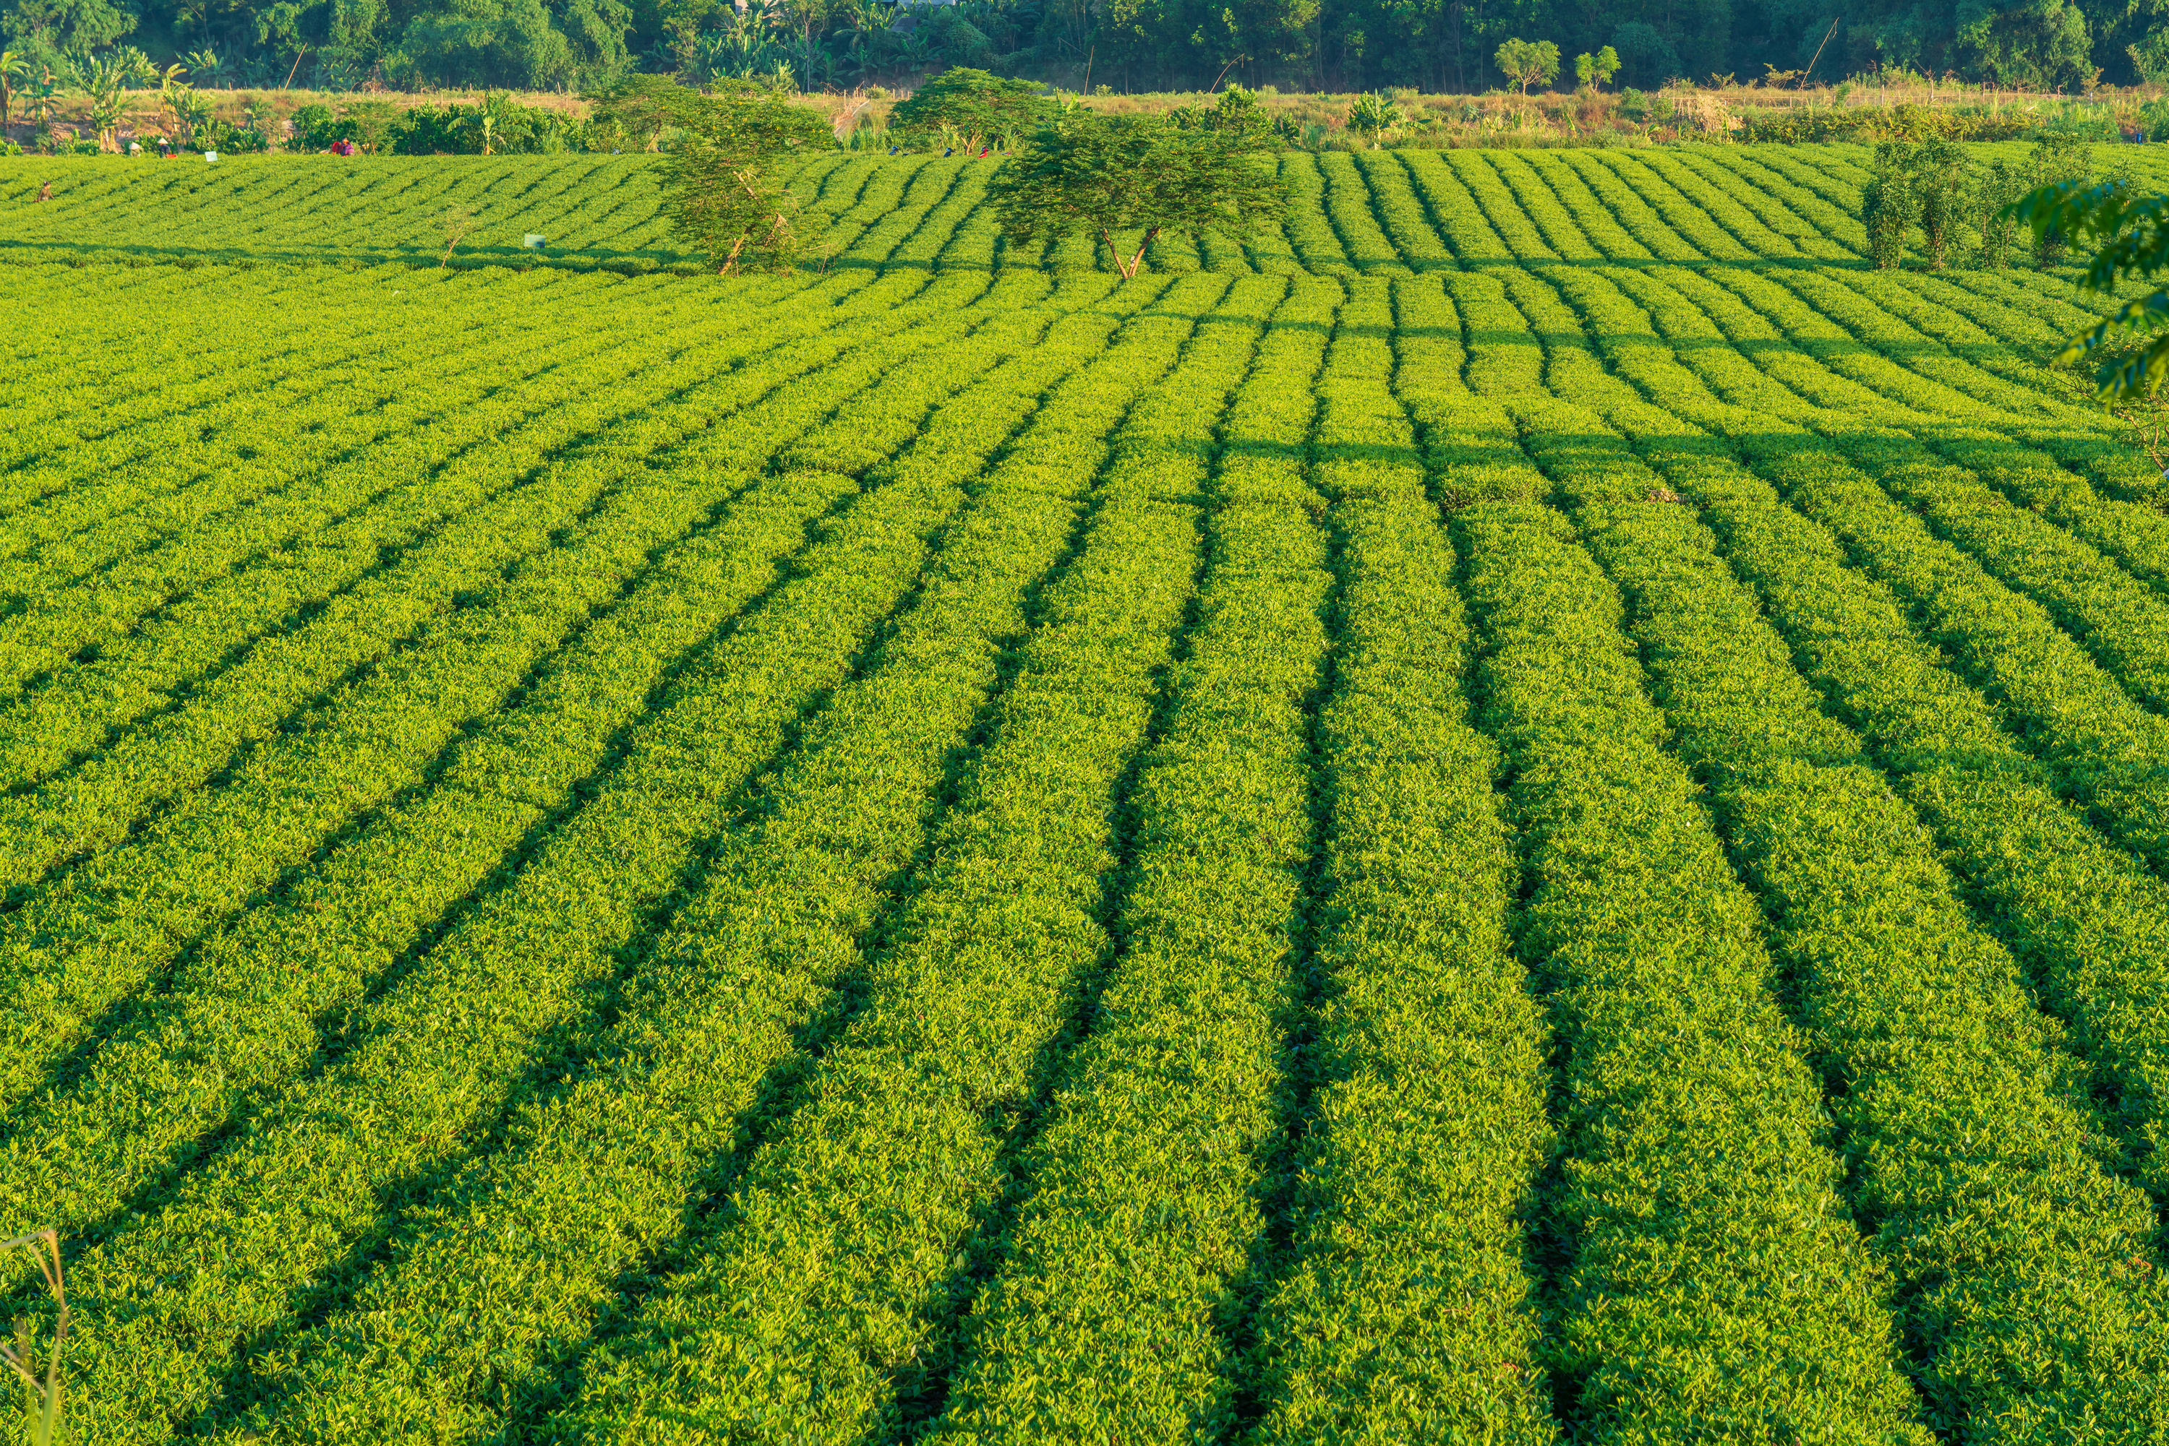

29/11/2024
A
g
r
I
THANK YOU

